Slide 1



EXPLORATORY PROJECT
APPLICATION OF MACHINE LEARNING IN DIFFERENTIAL EQUATIONS

Slide 2






SUBMITTED BY
PRANAV S
ADITYA KR G
NOORSHABA
PRIYANKA SONI
20124053
20124003
20124031
20124055
UNDER THE GUIDANCE OF
Prof V K SINGH
IIT BHU
DEPARTMENT OF MATHEMATICAL SCIENCE IIT BHU

Slide 3

INTRODUCTION
Machine Learning(ML) is the study of computer algorithms that can improve automatically through experience and by the use of data. It is seen as a part of artificial intelligence. Machine Learning algorithms build a model based on sample data, knowing as training data, in order to make predictions or decisions without being explicitly programmed to do so. In the present world Machine Learning and AI have developed that much as the countries having the greatest advancement in this field are now considered strongest in the world. The day where machines talk, see and interact better than humans are so close. Machine learning and mathematics are considered as the best couples in the scientific world. These facts led us to choose and explore “The Application of Machine Learning in Differential Equations” as our Exploratory project under the Department of Mathematical Science guided by Prof V K Singh.

Slide 4
Project Overview
In this project, we learnt various aspects related to machine learning and its application in solving Differential Equations.
Analysis of research paper by Maziar Raissi: In this paper we explored deep learning of non-linear partial differential equations.
Here we used two deep neural networks to approximate the unknown solution.
Analysis of research paper by Hayden Schaeffer: In this paper we learnt another way of solving partial differential equations via Data Discovery and Sparse optimization.

Slide 5
Hidden physics model:
Deep Learning of Nonlinear Partial Differential Equations
-Maziar Raissi

Slide 6

Hidden physics model:
Deep Learning of Nonlinear Partial Differential Equations
This paper written by Maziar Raissi put forth a deep learning approach for discovering nonlinear partial differential equations from scattered and potentially noisy observations in space and time.
In physics-informed deep learning we construct structured nonlinear regression models that can uncover the dynamic dependencies in a given set of spatio-temporal dataset, and return a closed form model that can be subsequently used to forecast future states.
Specifically, we consider nonlinear partial differential equations of the general form:
u_{t} = N (t, x, u, u_{x}, u_{xx}, . . .)
where N is a nonlinear function of time t, space x, solution u and its derivatives.
In this form the solution u is quite noisy and scattered .Here we are interested in learning the non linear function N and consequently discovering the hidden laws of physics that govern the evolution of observed data.

Slide 7
NOTHING IS PERFECT IN THIS IMPERFECT METHOD
There are two drawbacks with above method:
It relies on numerical differentiation to compute the derivatives involved in equation. Numerical approximations of derivatives are inherently ill-conditioned and unstable even in the absence of noise in the data because of the limited precision in computation and chosen value of step size. Therefore this process requires far more data points than library function. This need for using a large number of points lies more in the numerical evaluation of derivatives than in supplying sufficient data for the regression.
While we applied the algorithm we assumed that the library is sufficiently rich to have a sparse representation of the time dynamics of the dataset. But actually in the dataset the time dynamics is unknown and in higher dimensions the above assumption fails. Also this approach can only determine the coefficients. Also this method cannot estimate the parameters of PDEs involving a term like sin(αu(x)) where α is the unknown parameter.

Slide 8
GOING INTO A SOLUTION
01
02
The first drawback can be rectified by assigning prior distributions in the forms of neural networks to the unknown solution u.
Derivatives of the prior on u can now be evaluated at machine precision using symbolic or automatic differentiation and this also removes the need to generalise the data on derivatives and also helps us to reduce data points.
The second drawback can be rectified by approximating the non linear function N with a neural network .
The paper discuss the approach of representing the nonlinear function N by a deep neural network.

Slide 9
SOLUTION METHODOLOGY
We approximate both the solution u and the nonlinear function N with two deep neural networks. We define a deep hidden physics model f as:-
f:= u_{t}-N(t,x,u,u_{x}, u_{xx},...)
Derivatives of u with respect to time t and space x is obtained by using Automatic differentiation.
The basic idea of automatic differentiation is:
All numerical computations are ultimately composed of elementary operations whose derivatives are known.
Combining the derivatives of the constituent operations through the chain rule gives the derivative of the overall composition.

Slide 10
SOLUTION METHODOLOGY
Parameters of neural networks u and N can be learned by minimizing the sum of squared errors.
_{i=1}^{N}𝚺(|u(t^{i},x^{i})-u^{i}|²+|f(t^{i},x^{i})|²),
where, {t^{i},x^{i},u^{i}} denote training data on u,
The term |u(t^{i} , x^{i} ) − u^{i}|² tries to fit the data by adjusting the parameters of the neural network u while the term |f(t^{i}, x^{i} )|² learns the parameters of the network N by trying to satisfy the partial differential equation at the collocation points (t^{i} , x^{i}).

Slide 11
IMPLEMENTATION OF THE LEARNT METHOD
Burgers’ equation
In one space dimension the Burgers’ equation reads as
u_{t} = −uu_{x} + 0.1u_{xx}
To obtain a set of training and test data we simulate the Burger’s equation using conventional spectral methods.
Given the training data, we are interested in learning N as a function of the solution u and its derivatives up to the 2nd order
u_{t}= N (u, u_{X}, u_{xx})
Here u is a a 5-layer deep neural network with 50 neurons per hidden layer and N a neural network with 2 hidden layers and 100 neurons per hidden layer. These two networks are trained by minimizing the sum of squared errors loss of equation and the result is obtained. We solve the learned partial differential equation , along with periodic boundary conditions with the same initial condition as the one used to generate the original dataset, using the PINNs algorithm to check the effectiveness..

Slide 12
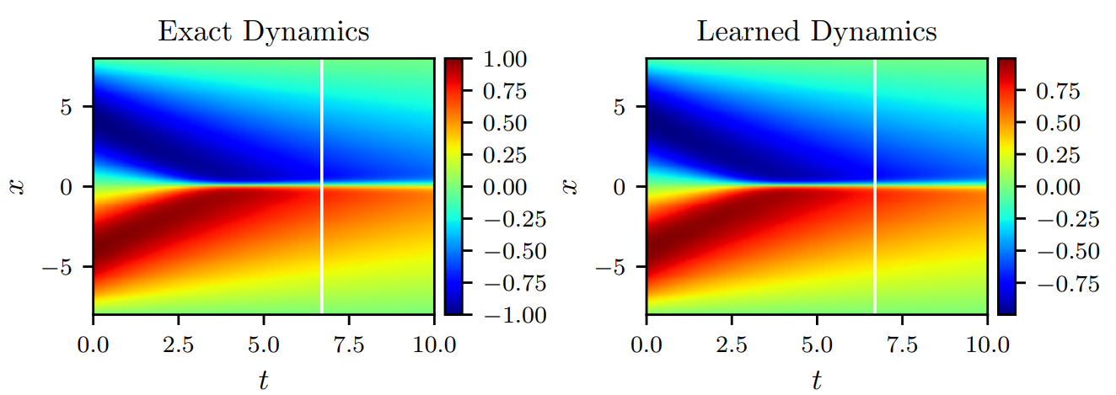
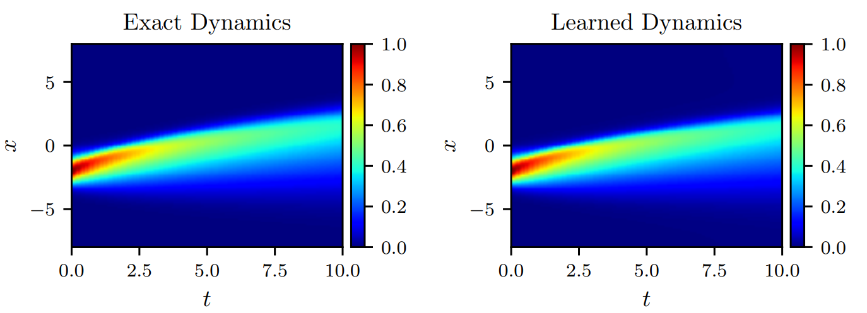
COMPARISON OF RESULTS AT VARIOUS INITIAL CONDITIONS
Using u(0, x) = − sin(πx/8), x ∈ [−8, 8] as initial condition
Using u(0, x) = − -exp(-(x+2)²) , as initial condition

Slide 13
2. KdV Equation
The Korteweg–De Vries (KdV) equation is a mathematical model of waves on shallow water surfaces. KdV equation reads as
u_{t} = −uu_{x} − u_{xxx}
To obtain a set of training data we simulate the KdV equation using conventional spectral methods.Given the training data, we are interested in learning N as a function of the solution u and its derivatives up to the 3rd order
u_{t} = N (u, u_{x}, u_{xx}, u_{xxx})
Here u is a a 5-layer deep neural network with 50 neurons per hidden layer and N a neural network with 2 hidden layers and 100 neurons per hidden layer.
These two networks are trained by minimizing the sum of squared errors loss of equation. We solve the learned partial differential equation , along with periodic boundary conditions and the same initial condition as the one used to generate the original dataset, using the PINNs algorithm.

Slide 14
Inference
In the research paper deep learning approach for extracting nonlinear partial differential equations from spatio - temporal dataset were discussed in detail. The algorithm proposed in the paper leverages the recent developments in automatic differentiation to construct efficient algorithms for learning infinite dimensional dynamic systems using deep neural networks.
BUT!
These types of method and solvers are still in their infancy. There are a lot more questions existing in this field on which further research is needed. Some of them are:-
Many real-world partial differential equations depend on parameters and, when the parameters are varied, they may go through bifurcations.
Application of convolutional architectures for mitigating the complexity associated with partial differential equations with very high-dimensional inputs.

Slide 15
Partial Differential equations via Data Discovery & Sparse Optimization
-Hayden Schaeffer

Slide 16
Partial Differential equations via Data Discovery & Sparse Optimization
Objective: To learn underlying PDE only using data. For this we need to :
- Identify terms of PDE (Form of model)
- Approximate coefficient of terms (Parameter estimation)
Approach: 1. Symbolic Regression 2. Sparse regression
In this work, rather than using symbolic regression , a sparse optimization method is proposed for identifying the underlying PDE to a given data set. Learning algorithm for this uses sparse optimization for feature selection and parameter estimation.
Sparse optimization theory deals with sparse solutions for systems of linear equations.

Slide 17
L1 Norm and L1 Regularisation
L1 Norm: ||A||₁ = Σ|A_{i}|
LASSO Regression is commonly used in data fitting, with the L1 norm on the unknown coefficients.
It is basically L1 Regularization:
(1/n) Σ(y_{i}-h_{ϴ}(x_{i}))² + λ Σ|θ_{i}|
Here λ is balancing parameter.
The L1 norm is used to penalize the number of non-zero coefficients in order to promote coefficient sparsity.
The L1 norm is often used as a proxy for sparsity.

Slide 18
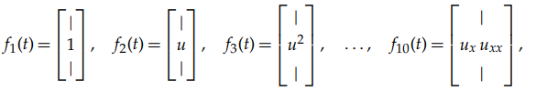
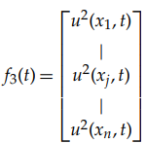
Motivation and Model
We will derive the proposed method for a specific example. Consider the viscous Burgers’ equation given by:
u_{t} = (u²/2)_{x}+vu_{xx}
Assume that the form of the equation is unknown, and instead we consider the general form for second-order PDEs with quadratic nonlinearity (in space).
u_{t} = α₁ + α₂u + α₃u² + α₄u_{x} + α₅u_{x}² + α₆uu_{x} + α₇u_{xx} + α₈u_{xx}² + α₉uu_{xx} + α₁₀u_{x}u_{xx}.
The r.h.s. can be obtained by approximating a general second-order evolution equation u_{t}=F(u,u_{x},u_{xx}) via a second-order Taylor expansion.
u_{t} = [1 u u² u_{x} u_{x}² uu_{x} u_{xx} u_{xx}² uu_{xx} u_{x}u_{xx}] · α.
We define feature vectors f_{l}(t) by:
For example if n spatial points are given , third feature vector will be defined as:

Slide 19
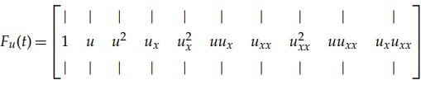
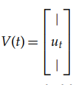
Considering f_{l}(t) as the feature vector, the collection of feature vectors defines the feature matrix, i.e.
F_{u}(t) = [f_{l}(t)] or
V(t) is the velocity vector.
for t > 0, the following system of equations holds: V(t) = F_{u}(t) α
The terms V and F are known while the coefficients α are unknown. Therefore, the problem is linear in the unknown α.
This equation is solved using L¹ regularized least square minimisation given by:
min_{α} ½ ∑॥V(t_{k}) − F_{u}(t_{k}) α॥₂² + λ॥α॥₁.
Here λ > 0 is a balancing parameter. The L1 regularization is chosen to promote sparsity in the vector α, with the modelling assumption that the underlying dynamics were governed by a few terms.

Slide 20
Numerical method and Algorithm
From the inference obtained by solving viscous Burgers’ equation we move on to a generalised method.
If we have the data w(x,t) at (possibly non-uniform) grid points x_{j} for 1 ≤ j ≤ N and time stamps t_{k} for 1 ≤ k ≤ M, we approximate the underlying evolution equation w_{t} = G(w) by:
Computing numerical approximations to the spatial derivatives of w(x,t).
Constructing feature matrix by collection of feature vectors.
Finally the coefficient of the terms are computed using least squares method.
min_{α} ½ ∑॥V(t_{k}) − F_{u}(t_{k}) α॥₂² + λ॥α॥₁.

Slide 21
Method of approach
Step
01
Step
02
Step
03
Initially w(x, t) will be given, from that we have to calculate all spatial derivatives (up to some order) using the spectral method.
Construct feature vectors via algebraic equations of the spatial derivatives.
Use the Douglas–Rachford algorithm, equation, to solve the L1 least-squares problems.

Slide 22
Simulation and Numerical Experiments:
To test the method,
Data are simulated using the Crank–Nicolson method. The simulated data u(x,t) is assigned to the variable w⁰(x,t).
The noise-free velocity w⁰_{t} is computed by a first-order backward difference:
w⁰_{t}(x_{j}, t_{k}) ≈ [w⁰(x_{j}, t_{k}) − w⁰(x_{j}, t_{k}−1)]/ dt , where dt > 0 is the time step.
The computed velocity w⁰_{t} is corrupted by additive Gaussian noise.
The noisy velocity is assigned to w_{t}.
The noise level is displayed for all examples by measuring the ratio between the L2 norm of the noise and the L2 norm of the data, i.e.
noise level = (||w_{t} − w⁰_{t}||₂ × 100%)/ ||w⁰_{t}||₂
All spatial derivatives are approximated using the spectral method, and features are computed via direct products. All features are computed using w⁰_{t}(x_{j},t_{k}).
In all examples, the Douglas–Rachford algorithm parameters are set to γ = 1/2, μ = 1, and the maximum number of iterations to 5000. Convergence of the iterates is achieved before the maximum iteration bound is reached.

Slide 23
Examples and Applications
Viscous Burgers’ equation:
u_{t} = (u²/2)_{x} + 𝛎u_{xx}
where 𝛎>0 is viscosity and x∈[0,1]
Data are simulated using the Crank–Nicolson method.
The balance parameter is fixed to λ = 500.
The feature space is made up of the terms from a third-order Taylor expansion using up to second-order derivatives.
The proposed algorithm is applied to the data with various levels of noise. For all noise levels, 2.0%, 19.5%, and 94.5%, the coefficients are identified to be within 1% in relative error.
This example shows that the method seems robust to noise.

Slide 24
2. Inviscid Burgers’ equation
To generate the solution to the inviscid Burgers’ equation, we simulate the viscous equation with 0 < 𝛎 <<1 and x ∈ [0, 1].
Data are simulated using the Crank–Nicolson method.
The balance parameter is fixed to λ = 500.
The feature space is made up of the terms from a third-order Taylor expansion using up to second-order derivatives.
The algorithm is applied to the data, with various levels of noise. For all noise levels, 1.5%, 15.0% and 73.7%, the coefficients are identified to within 2% in relative error.
As the noise level increases, the identification of the correct features stays stable. This shows the robustness of the method to noisy data.
In both examples, the dynamics are learned from t ∈ [0, 0.05] but the comparisons are done at T = 0.1, showing the possibility to extrapolate dynamics and predict critical events (such as shock formation).

Slide 25
3. Swift–Hohenberg equation
The Swift–Hohenberg equation is a scalar evolution equation with fourth-order derivatives:
u_{t} = −(1+Δ)²u+𝛂u+ꞵu²-u³
It is a model for thermal convection and solutions form various patterns depending on the choice of α and β.
E.g. (α, β) = (0.1, 0), (α, β) = (0.5, 0), (α, β) = (0.05, 0.5)
yield curves, yields a coral-like structure, yields a hexagonal structure.
The terms are all identified correctly and the coefficients are within 2.8% of the true value.
This example shows that, although the feature space contains redundancies (because Δu = u_{xx} + u_{yy}), the method is able to find the underlying dynamics.
It demonstrates the proposed method’s ability to identify the correct parameter regimes for the various patterns.

Slide 26
4. Cahn–Hilliard equation
u_{t}= -𝛾Δ²u+Δ(u³-u)
In this example, we will assume that the model takes the form: u_{t} = ΔF(u).
The data are simulated up to T = 2 using the Crank–Nicolson method with γ = 0.5.
Similar to example 3 the learning is stable with respect to redundancies in the feature space. The input data to the learning method use uniform time steps with a total of 385, 85 and 25 time stamps.
In all cases, the noise level is kept at 5.0%.
The Learned Coefficient show that the method is robust the number of time stamps used in the learning process.
This suggests that the proposed method is robust to the size of the data.

Slide 27
5. Navier–Stokes, low Reynolds number
The vorticity formulation for the two-dimensional Navier–Stokes equation is:
u_{t}+(▽⟂𝚫⁻¹u). ▽u = △u/Re
The vorticity is simulated using the Crank–Nicolson method with various Reynolds numbers (Re > 0).
The terms are all identified correctly and the coefficients are within 1% of the true value
Similar to example 3&4, the learning is stable with respect to redundancies in the feature space.
The Reynolds number is chosen to be small enough so that the dynamics are dominated by viscous flow.
The coefficient shows that the method identifies the viscous flow model, which is the true dominant behaviour of the data.

Slide 28
Inference
This work presented L1 regularized least-squares minimization to select the correct features that learn the governing PDE.
The identification of the terms in the PDE (form of model) and the approximation of the coefficients come directly from the data.
Advantages:
The numerical experiments show that the proposed method is robust to data noise and size, can capture the actual features of the data, and can perform additional tasks such as extrapolation, prediction, and (simple) homogenization.
Disadvantages:
This work shows a potential issue with this approach:
1. When applied directly to noisy data.
2. When different equations generate similar datasets (Model ambiguity).

Slide 29
COMPARISON OF BOTH THE PAPERS
Paper By Maziar Raissi
Paper By Hayden Schaeffer
A deep learning approach using neural networks for extracting nonlinear partial differential equations from spatio-temporal datasets.
Form of model is known.
Derivatives of u with respect to time t and space x is obtained by using Automatic differentiation.
The proposed framework provides a universal treatment of nonlinear partial differential equations of fundamentally different nature. This generality is demonstrated by applying the algorithm to a wide range of problems .
Sparse optimization method for identifying partial differential equation to a given data set.
Form of model is not known.
We construct derivative approximation using spectral method.
The proposed method is robust to data noise and size, can capture the actual features of the data.

Slide 30
SCOPE OF THE PROJECT TOPIC
The topic that we went through have a very high scope . By implementing machine learning to solve differential equations we can get the solution of more complex equations with a simple code if we have the sufficient data to process the output.
This is more useful in real life conditions where we have to solve differential equations of higher complexity and with large number of terms. Such as in fluid mechanics, stock prediction etc. By applying this technique we can understand the flow mechanism of a fluid in certain situations where it is nearly impossible or very difficult for humans to do the calculations and predict the mechanism.
In the case of financial mathematics these methods to solve differential equations can be utilized to predict the stock curve and this can be implemented in fintech applications.

Slide 31
OUR FUTURE PLANS
Go through the learned topics in depth and write a paper on ML in PDEs
SECOND YEAR
THIRD YEAR
Stream Project starts.
Learn the application of these techniques in stock prediction.
FOURTH YEAR
Develop an application for stock prediction based on the algorithms learned and developed through research
FIFTH YEAR
Improvement of the application.
Publish a thesis based on the work done in the previous years.

Slide 32
CONCLUSION
In this exploratory project we went through 2 research papers Hidden physics model:
Deep Learning of Nonlinear Partial Differential Equations by Maziar Raissi and Partial Differential equations via Data Discovery & Sparse Optimization by Hayden Schaeffer. Both the papers were quite interesting and also the methods and theories mentioned were new to us but were also very exciting to learn. We went through both the papers in depth and they opened the window of the vast field of various machine learning techniques that can be applied in complex mathematical problems. It was fun to explore and use Machine Learning which is born from mathematics to solve mathematical problems itself.
From the project we realised the vast research opportunities in our department and also we understood how to handle and review research papers.
We thank Prof V K Singh (IIT BHU), Dr Abhishek Kumar Singh (IIT Delhi) and the Department of Mathematical Science IIT BHU to for providing this wonderful opportunity to us.

Slide 33
THANK YOU

